Slide 1




Joint Group on Standards Side Event - Geospatial Standards in Action Monday August 5th 2019 at 16:00pm – 18:00pm Venue: Conf. Room 5 (General Assembly Building) UN Headquarters, New York
Open event
International
Organization for
Standardization
TC 211
Positioning geospatial information to address global challenges
Notes:
1

Slide 2
Agenda This side event is linked to UN-GGIM 9th session agenda item 15 on Thursday
Introductory remarks & Welcome Ms. Agneta Engberg, ISO/TC 211
Overview of standards work supporting the UN-GGIM and SDGs Moderator: Mr. Chris Body, Standards Australia & ISO/TC 211
Standards work with the United Nations Moderator: Mr. Mark Reichardt, Open Geospatial Consortium (OGC)
How to engage with the standards community & what important activities are planned for the next 12 months Moderator: Dr. Mathias Jonas, International Hydrographic Organization (IHO)

Slide 3

Cooperation
ISO/TC 211, OGC and IHO have been formally – and practically - co-operating since 1994.
They also benefit from a range of people working actively across organizations.
In 2015, the UN-GGIM adopted the Standards Guide, prepared jointly by ISO/TC 211, OGC and IHO
Notes:
ISO, OGC and IHO have been fomally co-operating since the birth of of IS/TC 211 and OGC in 1994.
Co-ordination is secured both through formal mechanisms – like coordination groups – but, equally important, by common people working actively across the standards organizations.

Slide 4

International Organization for Standardization (ISO)
World's largest developer of standards
Network of national standards institutes from 163 countries
19 500 standards published
Established in 1946-1947; Recognized by the UN
Principal activity is developing technical standards
Technical Committees (TCs)
From From food safety to computers, and agriculture to healthcare, ISO International Standards impact all our lives
ISO/TC 211, Geographic information/ Geomatics
www.iso.org
https://committee.iso.org/home/tc211

Slide 5

International Hydrographic Organization (IHO)
Intergovernmental consultative and technical organization
Established in 1921
To support safety of navigation and the protection of the marine environment
Relevant IHO objectives
to bring about the greatest possible uniformity in nautical charts and documents (i.e. standardization)
to support Marine Special Data Infrastructure

Slide 6

Open Geospatial Consortium
Industry consortium of over 530 members
2000+ implementations of standards and specifications, some certified to be compliant
Focus
Global forum of location expertise and agile processes combining standards, innovation and partnerships
Define, document and test implementation standards for use with geospatial content and services
Integration of geospatial content and services into applications for the benefit of mankind
www.ogc.org

Slide 7
UN-GGIM 2018 Decision 8/107 Implementation and adoption of standards
...expressed its appreciation to the three standards development organizations (SDO)…
…appreciated the revision of the Standards guide …
…commended the contributions, incl. the OGC statistical domain working group, the ISO land administration domain model standard (LADM), the IHO S-100 suite of standards incl. the S-121 (maritime limits), the standard on classification systems for land cover…
…encouraged UN-GGIM regional committees and thematic groups to continue to raise awareness about, and engage in the promotion…
…encouraged Member states (MS) to participate…, and addressed the desire for broader engagement in order to facilitate interoperability of new standards and approaches…
Our report follows this up, and introduces some news

Slide 8
UN-GGIM 2019 Standards report Points for discussion
The Committee of Experts is invited to take note of
the report and express its views
the public release and availability of the ISO Geodetic Register and the progress of geodetic standards
the revision of ISO Land Administration Domain Model (LADM)
the OGC API standards, and the IHO S-100 framework
and to encourage Member States to participate in the work
on standards on Land cover & Land use
on the standard on Good practices for Address assignment
in the Statistics Domain Working Group
and through membership in OGC, ISO/TC 211, and IHO.

Slide 9
Objective and expected outcome Message
This side event aims to engage participants, member nations, observers, and experts in:
raising the awareness (use standards and Standards guide)
identifying the needs and participating in development & implementation (you are the experts)
assuring that the steps taken support the SDGs
foster the discussion of the challenges (we can support, but we need to overcome barriers, i.e. need for training)
We will highlight relevant parts of the GGIM9 Standards report.

Slide 10
Overview of Standards work supporting the UN

Slide 11
Areas of SDO support to UNGGIM
Integrated Geospatial Information Framework
Guide to the Role of Standards in Geospatial Information Management
Integration of Statistical and Geospatial information
Land Administration
Marine Geospatial Information
Sustainable Development Goals
Geospatial Information and Services for Disasters
Arctic Spatial Data Infrastructure

Slide 12

Standards are applicable to SDGs
E.g. 957 ISO standards are directly applicable to SDGs
https://www.iso.org/sdgs.html

Slide 13
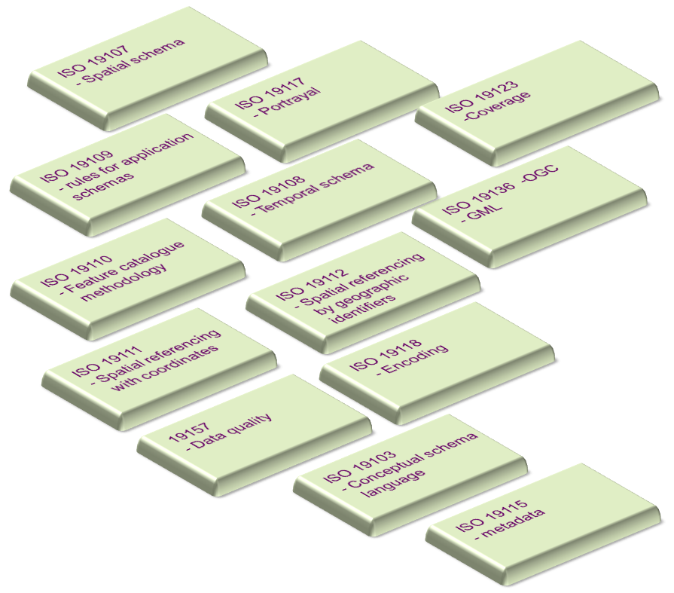
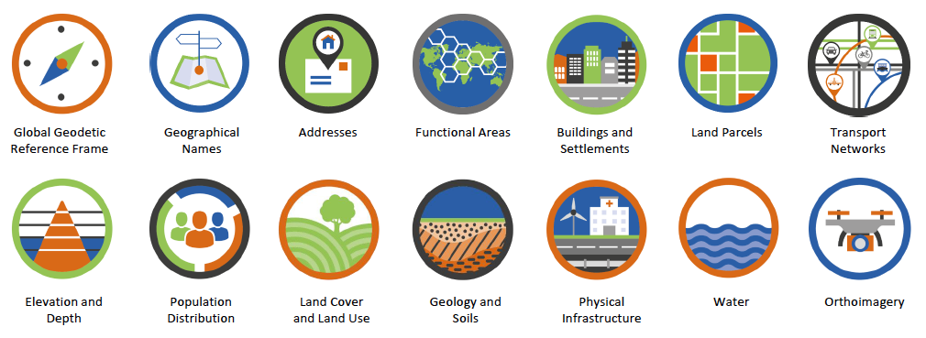
Standards support Fundamental data (which support SDGs)

Slide 14
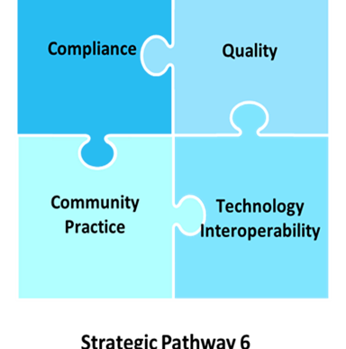
Standards support Integrated Geospatial Information Framework (which support SDGs)
Strategic Pathway 6 – Standards
Organization
Context and Rationale
Key Elements ->
Principles
Recommendations (for implementing a National Framework)
In work by ISO, OGC, IHO with draft expected by late August 2019.

Slide 15
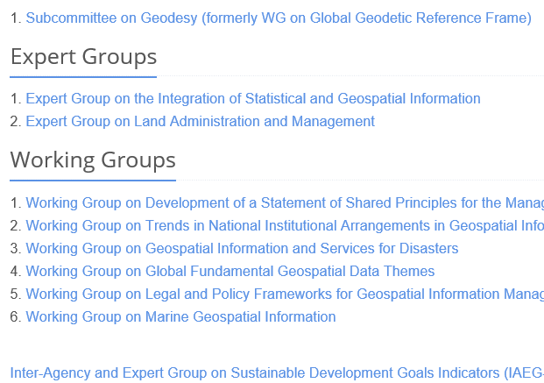
Overview of SDO support to UN-GGIM groups (which support SDGs)
Regional
IGIF – SP6 Standards
Chapter in book
Private sector
ISO ITRS
ISO Geodetic register
ISO DGGS
OGC Statistical DWG
ISO LADM
OGC Land Adm DWG
ISO Addressing
100+ fundamental and domain standards
Legal & Policy (OGC)
IHO S-100 Marine
OGC Marine DWG & Pilots

Slide 16

Other contributions
Contribution to Academic Network book
Sustainable Development Goals Connectivity Dilemma (Open Access): Land and Geospatial Information for Urban and Rural Resilience
1st Edition, Abbas Rajabifard
Chapter 14: The Role of Geospatial Information Standards for Sustainable Development
Contribution to World Geospatial Information Congress, Deqing, November 2018
http://ggim.un.org/unwgic/nov20-parallel-Standards-That-Make-Innovation-Possible/

Slide 17

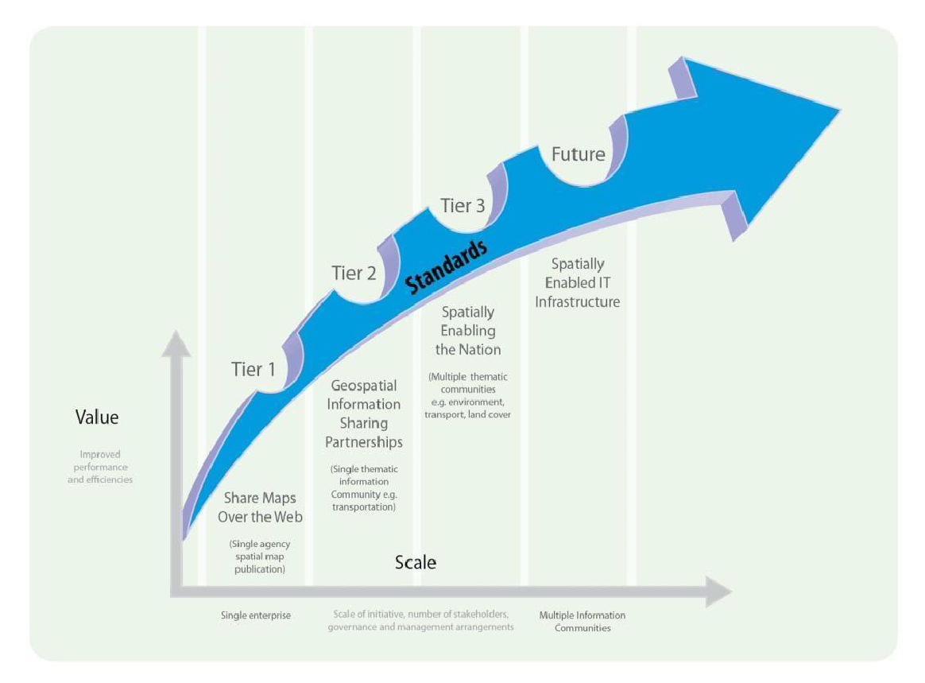
A Guide to the Role of Geospatial Standards & Standards Recommendations by Tier
Version 2 (2018) of the Standard guide has been prepared cooperatively by OGC, ISO/TC 211 and IHO.
The guide describes standards and related best practices, introduces a multi-tiered standardization levels of standards use. The companion document details available standards and their applications.
A Guide to the Role of Standards in Geospatial Information Management
Companion document on Standards Recommendations by Tier
Notes:
Will be made available for access on the Knowledge Management website and through the SDO webpages

Slide 18
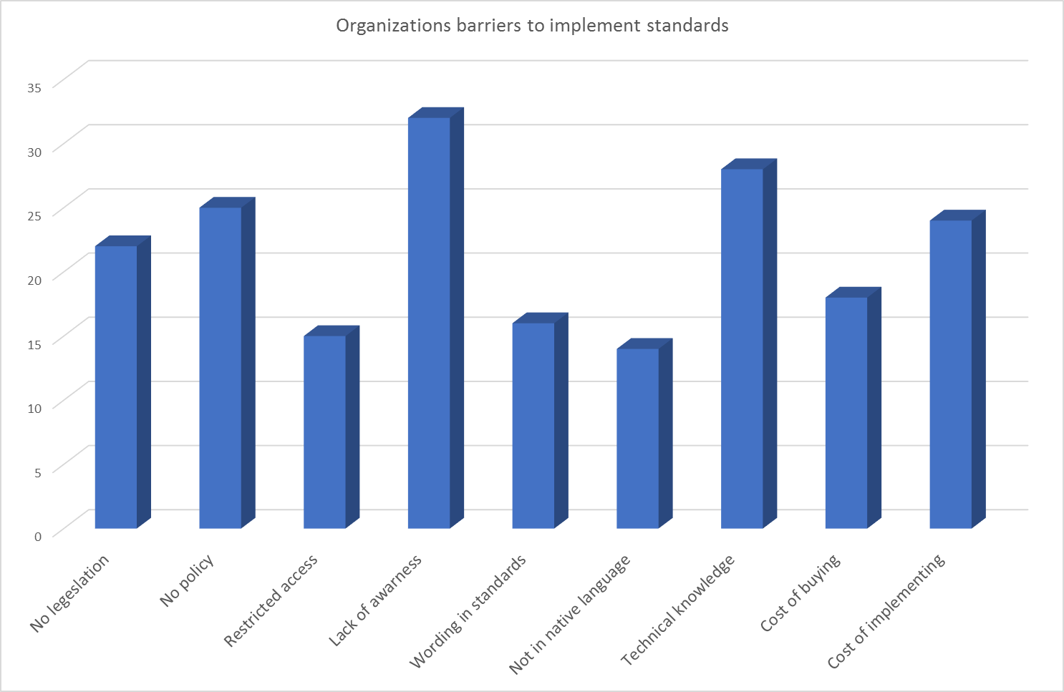
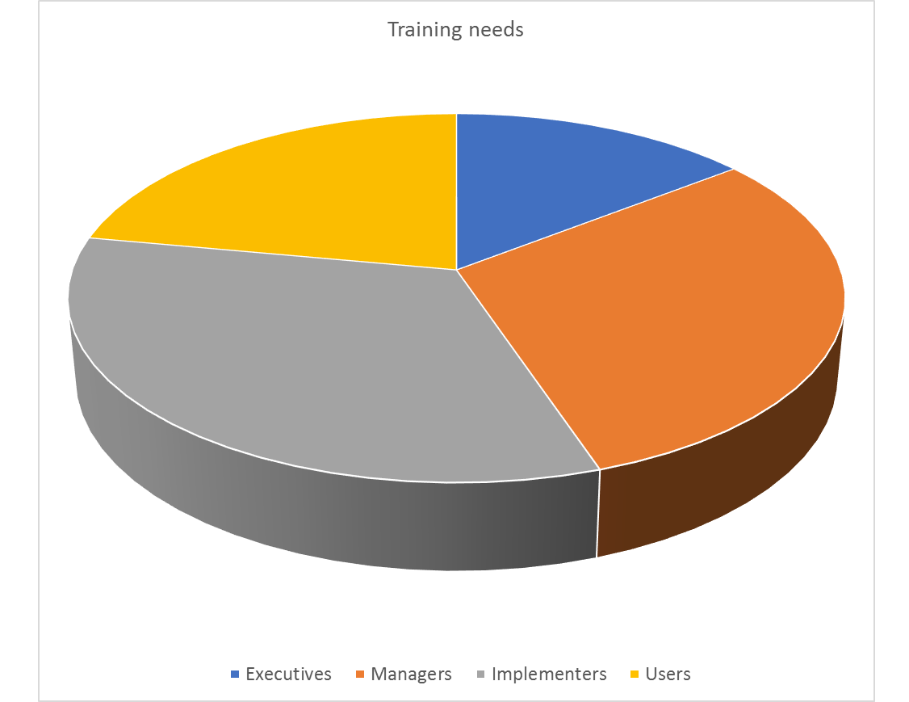
Survey 2018
Reported at GGIM8
Use of the Standards guides
Barriers for MS in implementing & participating
Reference to standards in legislation and policy frameworks
Need for training and outreach
Outcome
need for training
need to investigate interaction with supporting policies
http://ggim.un.org/meetings/GGIM-committee/8th-Session/side_events/1.Standards.pdf

Slide 19
Examples of ideas from the survey 2018 concerning training
Target groups, areas of cooperation
Raising awareness for policy makers
Working with the UN-GGIM Academic Network (and other WG, Expert groups)
Cooperation with universities
Partnerships with private sector for local level workshops
Ways to increase knowledge
Use cases contributed from Member States
Training at workshop, courses, webinars
Discussion forums on the web
Get-started-guides: “How use standards to solve this problem?”
Support material for interpretation and implementation
Translation of standards
Skills gap evaluation
Road map for implementation
Standards free of charge

Slide 20
Discussion
How do you think we can increase the awareness and knowledge of standards (e.g. through the Standards guide) for different target groups?

Slide 21
Standards work with the UN IHO OGC ISO/TC 211

Slide 22
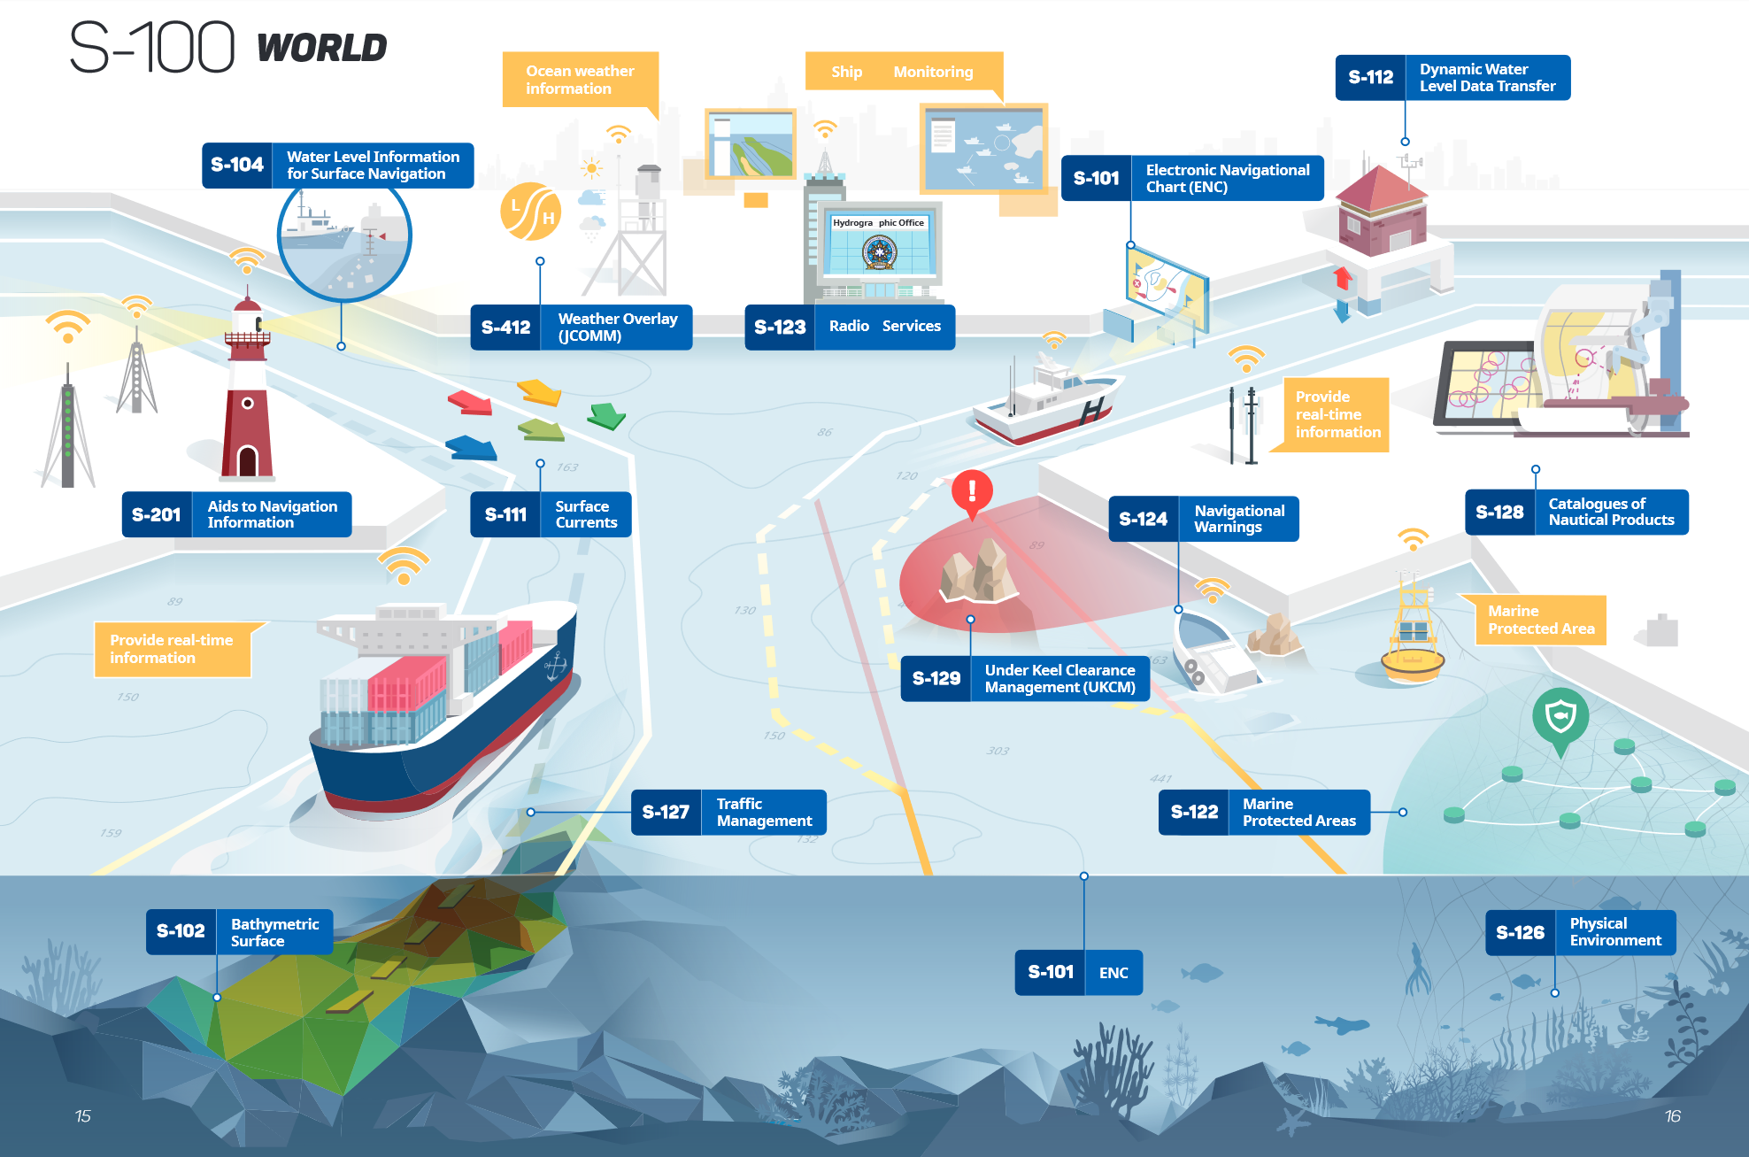
IHO´s S-100 Framework Standard supports the design of interoperable marine data products based on ISO modelling paradigms

Slide 23
IHO offers ISO 19100 compliant tools for creation and maintenance of marine data product specifications
Management of the S-100 Geospatial Information Registry: registry.iho.int
Product Specification Developers Guidebook (S-97)
template for building product specifications
Feature Catalogue Builder, Portrayal Catalogue Builder, Data Encoding and Classification Guide Builder
Data Security Scheme for uncorrupted dissemination

Slide 24




IHO tools are open for other marine science, enginereering and administrative domains
S-411 – S-414 Ice, Weather and Wave Information
S-421 Route Plan Exchange
S-201 – S-247 Aids to Navigation Information
S-121 Maritime Limits and Boundaries

Slide 25
The S-100 family of marine data product specifications allows flexibility in encoding to interface with OGC service standards
Examples of these include OGC standards such as
Keyhole Markup Language KML,
Geography Markup Language GML,
Web Coverage Service,
Web Feature Service and Web Map Service …
However,
There is a large gap in producing standards / specifications for surveying and ocean mapping.

Slide 26


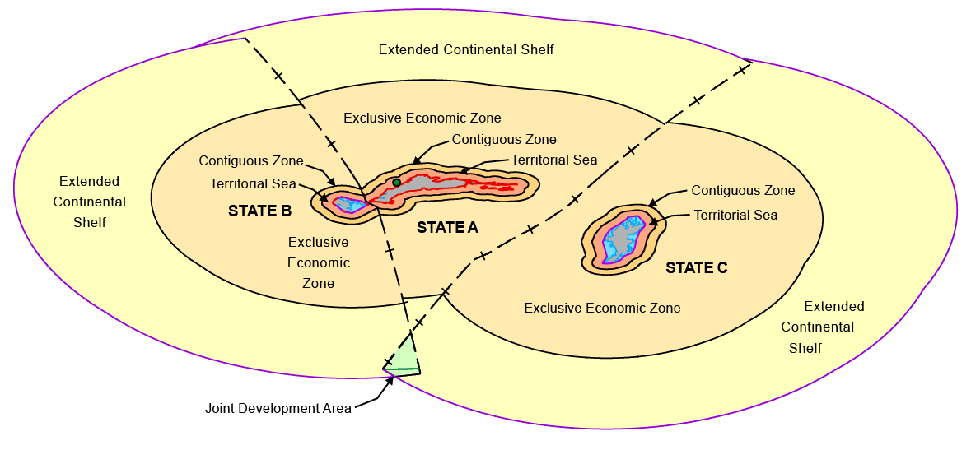
A best practice example: S-121 Maritime Limits and Boundaries
S-121 absorbs all relevant geospatial and legal information enabling the UN Member States to fulfill their formal deposit obligations for maritime limits and boundaries according to UN Convention of the Law of the Seas.
Interoperable data model
Specification for use cases
Application
Legal Declaration
An OGC S-121 Pilot Project aims operationalize the S-121 framework and datasets into real world applications using Commercial Off-The-Shelf software.
Authoritative Public Data
To service national and international SDI
Navigation and Enforcement
Notes:
S-121 is of special relevance for the UN framework since it provide a fully new opportunity for the member states to fulfill their formal deposit obligations according UN Convention of the law of the Sea. This standard has matured in comparably short time of development. Its practical application test is subject to pilot project conducted by OGC. This test will start in only a few weeks from now.

Slide 27
New OGC Domain Working Groups
OGC Domain Working Groups - identifying use cases, requirements, issues and opportunities for application of OGC and complementary standards to improve outcomes:
Agriculture*
Artificial Intelligence in Geomatics
Blockchain and Distributed Ledger Technologies
Interoperable Modeling & Simulation
Land Administration*
Marine*
Portrayal
Smart Cities*
Statistical
For the Complete List of OGC DWG’s see:
http://www.opengeospatial.org/projects/groups
DWGs are Open to all - Participate!

Slide 28
OGC Innovation Initiatives
Smart City Reference Architecture Pilot
Disasters Resilience Pilot
Marine SDI Concept Development Study
Marine SDI Pilot (Planned)
Maritime Limits and Boundaries Pilot
Indoor Mapping and Navigation Pilot
OGC API - Features Spring (planned)

Slide 29
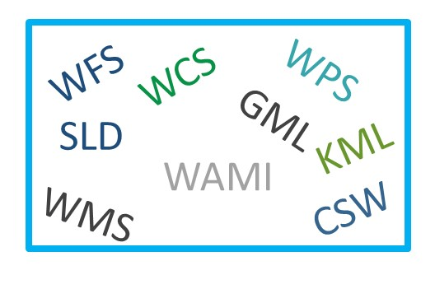
OGC API - The Next Generation of OGC Standards
Current: OGC Web Services
Supports geospatial information management - geodata publishing, discovery, access, processing, visualization, and application
Implemented worldwide
Underpins local to international Spatial Data Infrastructure Policy
Key components in UNGGIM Guide to Standards for Geospatial Information Management
WMTS
Notes:
OGC members have advanced a suite of OGC standards that are broadly implemented in the global community. OGC Web Services – consist of a family of standards designed to publish, discover, access, process, fuse, visualize and apply geospatial information.
Several of these standards have been profiled by NGA and the Defense Geospatial Information Working Group to address specific NGA and NSG interoperability requirements.
These standards are implemented in NGA as well as across the NSG to save time and effort required to integrate new data feeds, and to allow different GEOINT technologies to interoperate.
Data providers such as DigitalGlobe and exactEarth provide content via OGC standards to eliminate distribution and integration issues – as most nations and their respective agencies have adopted Spatial Data Infrastructures underpinned by OGC standards.
OGC is focusing now on Advancing a range of mobile applications to include as suite of sensor standards that enable the discovery, access, processing and integration of fixed and mobile sensor observations into a geospatial context. OGC recently approved SensorThings API that makes it easier to mash up feeds from IoT devices- as these devices are coming on line in the billions.
GeoPackage is enabling mobile devices both in a connected and disconnected environment as previously noted
Additional standards such as the Web Processing Service are enabling data to be processed ‘in place’ in the cloud, and is providing capability for processing social media feeds to find key information in the noise.

Slide 30
OGC API - The Next Generation of OGC Standards
OGC API builds on the success of OGC Web Services (W*S) Standards
Leverages Open API
Focus on getting content to the web, easing developer effort, expanding reuse in today’s app environment
Approach established as part of the recent revision of the OGC Web Feature Service, “OGC API – Features” will be first to approval in 2019
Additional OGC W*S standards will follow the same pattern:
OGC Web Services Common 🡪 OGC API – Common
Web Processing Service 🡪 OGC API – Processing
Web Map Tile Service 🡪 OGC API - Map Tiles
Web Coverage Service 🡪 OGC API – Coverages
Catalogue Services for the Web 🡪 OGC API - Catalogue

Slide 31
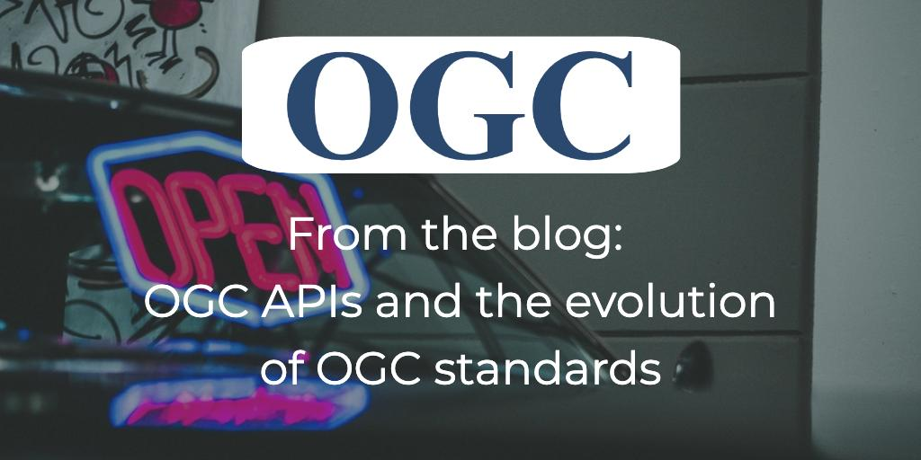
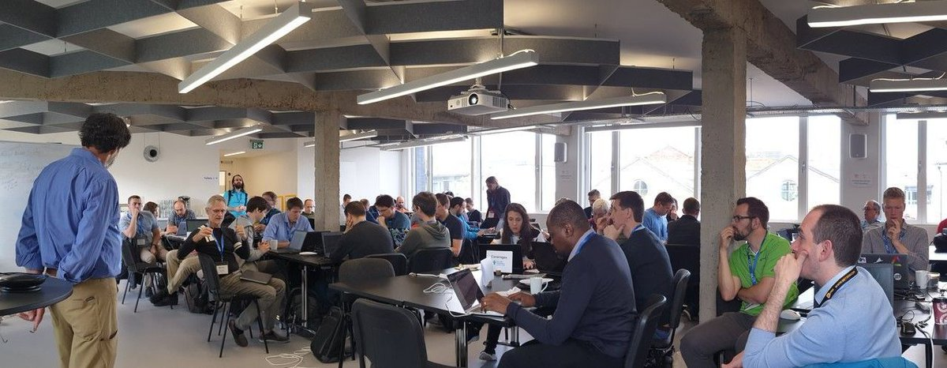


OGC API - The Next Generation of OGC Standards
OGC members are engaging with the developer community via hackathons, sprints and public GitHub to evaluate applicability and utility
OGC Web Services standards will continue to be supported, but with minimal future revision
Revisions will be made to UNGGIM Guide to Standards for Geospatial Information Management
http://www.opengeospatial.org/blog/3025
#OGCAPI

Slide 32
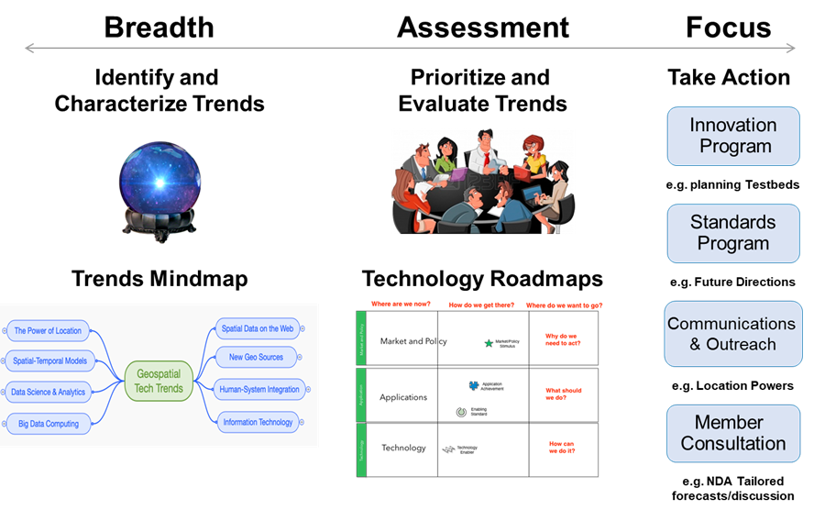
OGC Technology Trends / Forecasting

Slide 33
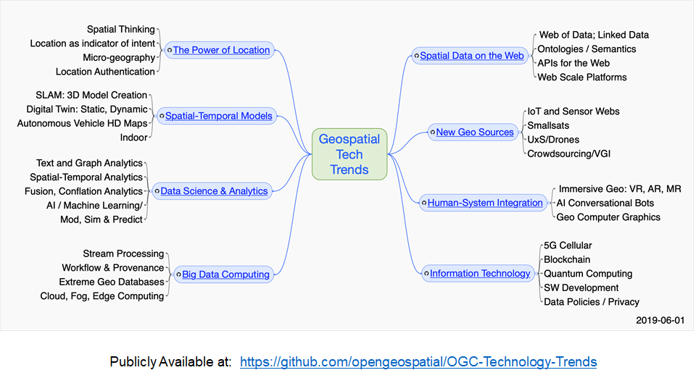
OGC Technology Trends / Forecasting
MindMap

Slide 34
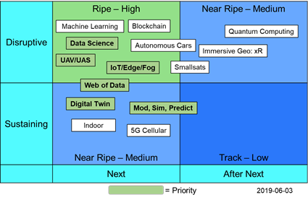

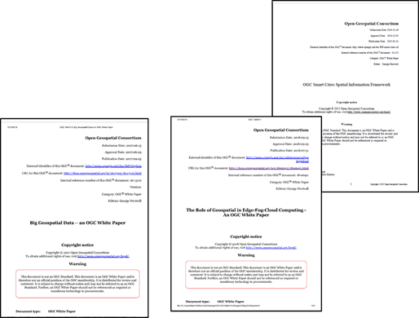
OGC Technology Trends / Forecasting

Slide 35
ISO/TC 211 projects to support the UN
Land Administration Domain Model (LADM)
Supports Land Administration, Fundamental Data
Land Cover & Land Use
Supports SDG 2
Addressing
Supports Fundamental Data, Land Administration, Disaster Management, and SDG 1,3,6,7,8,9,10,11,16
Geodetic reference & grid systems. ISO geodetic registry
Supports SC Geodesy, Fundamental Data, Supports Statistics

Slide 36

Land Administration Domain model (LADM)
PLANNING STAGE
Revision of ISO 19152 LADM to meet new requirements from different domains, in a multi-part standard as follows:
Land Administration Fundamentals
Land Tenure
Marine Space
Land Valuation
Spatial Planning
Implementations

Slide 37

LADM cont.
12 Month gathering of use cases and submissions
Initial inputs from FIG, OGC, IHO, UN-DOALOS, UNGGIM and Royal Institution of Chartered Surveyors (RICS)
Update after Maribor, Leuven
Participants Industry,
Use cases,
Testbeds, pilots
Stage 0 document was issued providing guidance for the LADM Edition II

Slide 38
LADM cont.
Call for new work items proposals for the various parts will be issued by Oct 19
Land Administration Fundamentals - Part 1 will provide the overview and scope for the other parts
Each part will be lead by their community of experts (eg. Marine Space - IHO & UN-DOALOS)
Participate!

Slide 39


Land Cover and Land Use
PLANNING STAGE
Draft scope for the revision and development of Classifications systems standards:
Revision ISO 19144-2 Land Cover Meta Language
Will also support the EIONET requirements and ensure that the EAGLE model will be a valid profile. Work is expected to start in December 2019
New ISO 19144-3 Land Use Meta Language
Work is expected to start after December 2019
New ISO 19144-4 Registers for Land Cover & Land Use
Participate!

Slide 40

Addressing
What is an address?
Classes or types: street address, box address…
Components: street number, street name, place name…
ISO 19160-1 Conceptual model
ISO 19160-3 Data Quality
ISO 19160-4 Rendering on mail items
ISO 19160-6 Profile interchange
Values or names
Street number=392
Street name=Church Street
Place name=Pretoria
SOON PUBLISHED
Mr Joe Soap
392 Nelson Mandela Dr
ZA-0087 Polokwane
IN PROGRESS

Slide 41


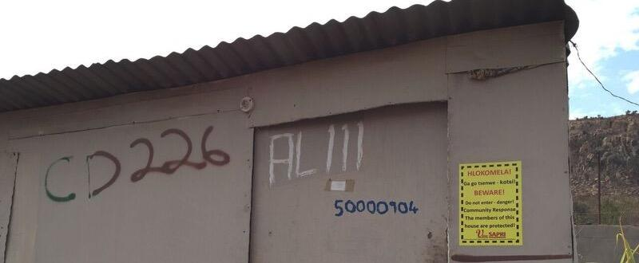
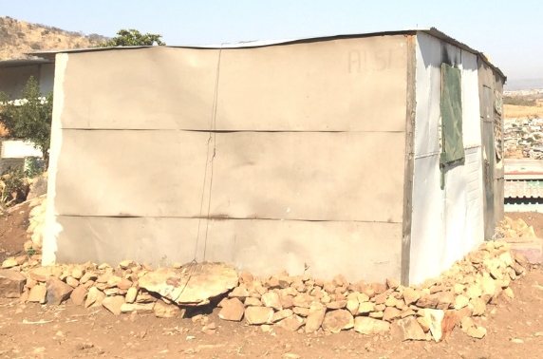
Addressing – How to assign addresses
PLANNING STAGE
ISO 19160-2 Address Assignment
Similar to ISO 9000, specifies good practice
Useful as tender or funding requirement
1257.3393
Participate!

Slide 42

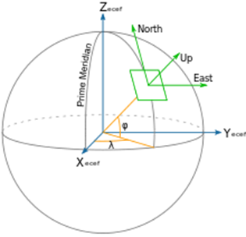
Geodesy Standards
Revision of ISO 6709 Standard representation of geographic point location by coordinates
ISO 19162 Well-known text representation of coordinate reference systems
The state-of-the-art encoding of coordinate references
ISO 19111 Spatial referencing by coordinates
The state-of-the-art description and model for positions
ISO 19161-1 International Terrestrial Reference System (ITRS)
Essential for the consistent realization of International Terrestrial Reference Frame (ITRF) and the Global Geodetic Reference Frame (GGRF)
Ref. to UN General Assembly resolution A/RES/69/266 on GGRF for SDG
IN PROGRESS
REVISED
REVISED
MODERNIZED
IN PROGRESS

Slide 43


ISO Geodetic Registry https://registry.isotc211.org
PUBLICALLY RELEASED 2019
The Registry is an authorized, quality assured, international register for coordinate reference systems & transformations, and accessible by an on-line system. Conforms to ISO 19127 Geodetic register and other ISO standards. Control body of geodetic experts.
“Recognizing the development of ISO 19161-1 ITRS, the Sub-Committee urges Member States to record their national reference frame details, and its alignment to the ITRF, in the ISO Geodetic Register” (UN-GGIM SC Geodesy, Nov 2018)
Register - it is free! Use it!

Slide 44
Geodesy Standards
IN PROGRESS
ISO 19170 Discrete Global Grid Systems (DGGS)
Foreseen use for Statistic purposes in various applications, e.g. land use

Slide 45
OGC Marine Limits & Boundaries Pilot
The pilot will advance the implementation of the IHO S-121 Maritime Limits and Boundaries Standard, which is an essential extension of the IHO S-100 Universal Hydrographic Data Model
Develop supporting data model and architecture (OGC/ISO GML)
Implement operational prototypes to support the creation, management, integration, dissemination and onward use of official data for maritime baselines, limits, zones and boundaries.

Slide 46
Goal
Focus on demonstrating the ability to support:
Country level publication, as a national obligation, of their maritime baselines, limits and boundaries
Standards-based geospatial interoperability between suppliers, users and partners, within and across governments, public and commercial users
Facilitating strategic awareness and operational decision making in the maritime environment supporting good governance and effective and efficient operations

Slide 47
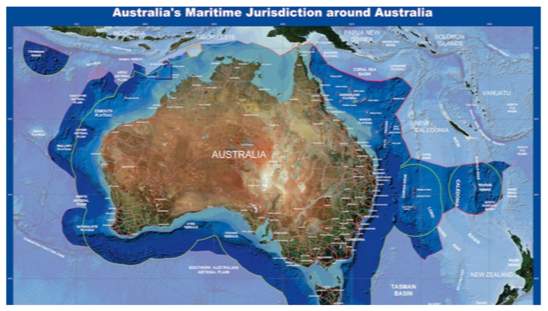
OGC Maritime Limits & Boundaries
Sponsors:
Geoscience Australia
Canadian Hydrographic Service
Natural Resources Canada
United Kingdom Hydrographic Office
Main Page
Call for Participation

Slide 48
Schedule
Feb 25 2019 | Call for Participation
March 12 2019 | Clarifications Webinar
Mar 19 2019 | Response due Call for Participation
Mar 23 2019 | Selection of Participants and Bidder Notifications
Mar 28 2019 | Participation Agreements
May 14-15 2019 (Ottawa) | Kickoff Phase I
Sep 26 2019 | End Prototype Development Phase 1
Sep 26 2019 | Draft Report Phase 1
October 2019 | Virtual Kickoff Meeting Phase 2
Feb 21 2020 | Engineering Report
Mar 18 2020 | Demonstration
Mar 31 2020 | End Prototype Development Phase 2

Slide 49
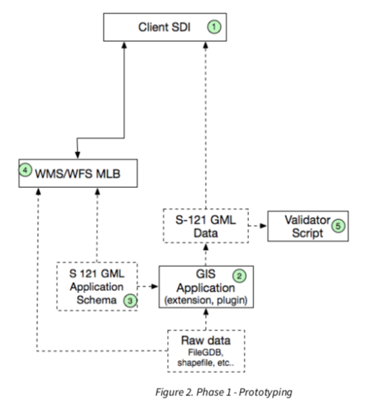
Phase 1
Focuses on advancing GIS Applications to implement the S-121 Data Model. The primary task is to develop a GML Application Schema that properly represents the data model. GIS Applications, based on the GML Application Schema, will read raw data and convert to S-121 and validate.

Slide 50
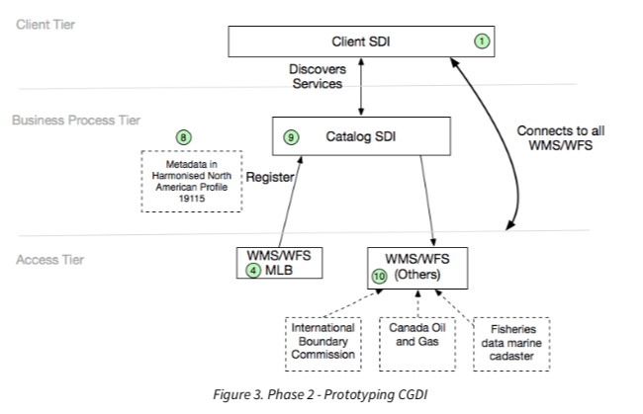
Phase 2
Prototype components to build Marine Spatial Data Infrastructures.
Components include:
metadata profiles,
catalog,
demonstrating the toolset interoperability with other types of data (e.g. International Boundary Commission, Canada Oil and Gas, and Fisheries Data Marine Cadaster).

Slide 51
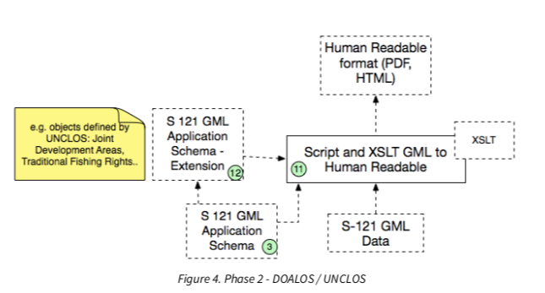
Phase 2 (cont’d)
Tools to convert S-121 geodata in GML to human readable format for delivery to the United Nations Convention for the Law Of the Sea (UNCLOS)

Slide 52

For More Information
OGC Innovation Program
Active Initiatives
Contact:
Luis Bermudez
Executive Director, Innovation Program
lbermudez@ogc.org

Slide 53
How to get involved
ISO/TC 211
National Standards Bodies
Liaison
Invited experts
OGC
Open Membership (fee)
Domain Working Groups (public open)
Innovation Programs
IHO
Intergovernmental consultative & technical organisation
Liaison

Slide 54

Thank you
Positioning geospatial information to address global challenges
Notes:
54

